Slide 1
Team and Tools
Dirk Riehle, FAU Erlangen
AMOS B01
Licensed under CC BY 4.0 International

Slide 2
Agenda
Team formation
Student roles
Team contract
Team logo and T-shirt
Project tools
Planning document
Feature board
Imp-squared backlog
Team coordination
Code repository
Stand-up emails
Happiness index

Slide 3
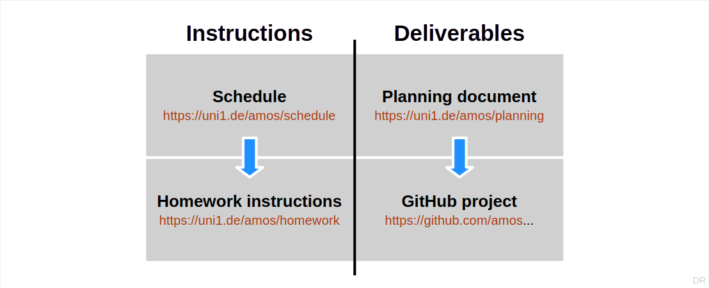
Instructions and Deliverables

Slide 4
1. Student Roles

Slide 5
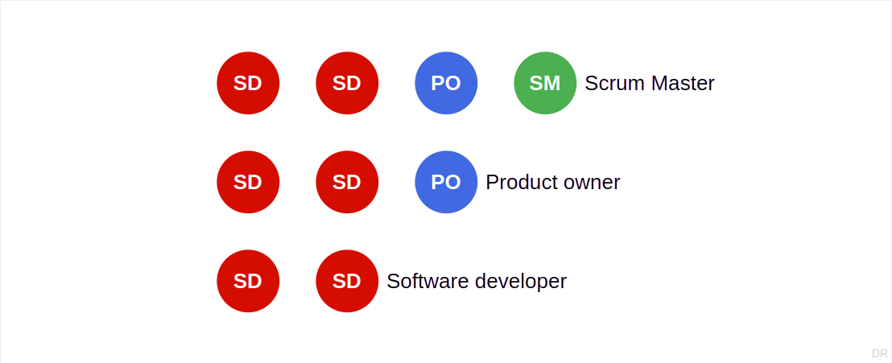
The AMOS Scrum Team [1]
[1] Scrum guide: One Scrum Master, one product owner, software developers

Slide 6
Scrum Roles
Product owner
Holds overall responsibility that the software is valuable (to customers)
Software developer
Holds overall responsibility for design and implementation of the software
Scrum Master
Holds overall responsibility for continuous process improvement

Slide 7
Additional Roles
Release manager
Holds overall responsibility that a demo is ready for review

Slide 8
There is no Project Manager
Scrum teams are self-organizing

Slide 9
First Industry Partner Meeting
You should have a first meeting with your industry partner as soon as possible
Team members in general participate to learn about project
Product owners participate to gather requirements
Software developers participate to ask technical questions
After the first team meeting you should still try to regularly meet the industry partner
As many team members should participate as is sensible and possible

Slide 10
2. Team Contract

Slide 11
Team Contract
A team contract is
A contract between team members on how to conduct the project
Its main components are
Goals and rewards
Norms and sanctions

Slide 12
Goals and Rewards
Goals are what the team hopes to achieve; there are several categories:
Learning objectives, for example,
To ensure that all team members understand the course material
Interpersonal relationship objectives, for example,
To foster an atmosphere of mutual respect and learning
Functional objectives, for example,
To have efficient team meetings
Rewards are how you celebrate intermediate or final achievements
Let’s have cake!

Slide 13
Norms and Sanctions
Norms are rules for expected behavior; there are several categories:
Meeting norms, for example,
Is being late to a team meeting acceptable?
Working norms, for example,
How will we make decisions?
Coordination norms, for example,
Who keeps meetings on track?
Communication norms, for example,
How to communicate outside of team meetings?
Sanctions are what to do if norms are violated
Sing a song to the team or do ten push-ups

Slide 14
One-Time Deliverable: Team Contract
Please discuss and agree on a team contract (in planning document)
Try to finish this during the first team meeting

Slide 15
3. Team Logo and T-shirt

Slide 16

Team Logo
A team logo is just that, a logo that
Represents your team and project
The logo will be used in different places
On your team T-shirt
In the GitHub documentation
In your final demo and report
Wherever you see fit

Slide 17
Team Logo Design
Get started with collaboratively designing the team logo during the team meeting
Continue on your self-chosen communication channels
Final execution (graphics) may be delegated to one person

Slide 18
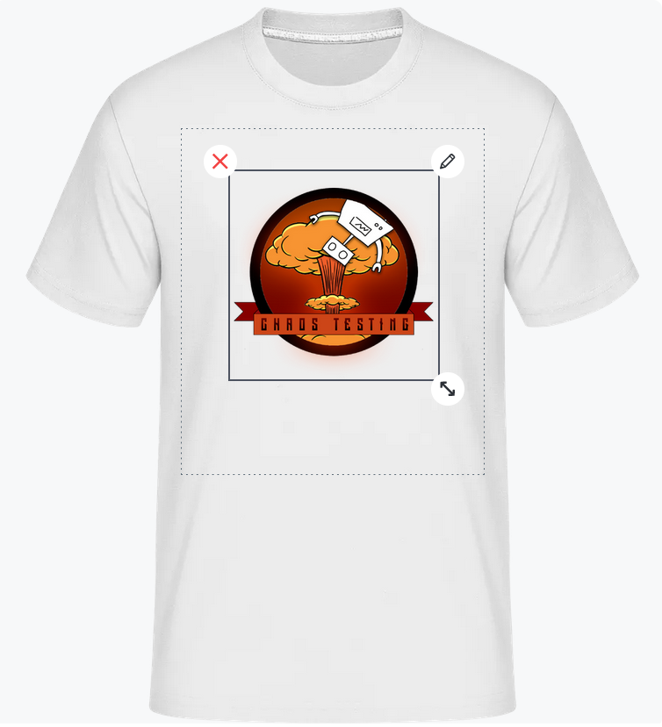
Team T-shirt
Create a team T-shirt design using your logo
You can add your logo and one text
Submit your team T-shirt preferences
Color, size, form

Slide 19
One-Time Deliverable: Team Logo / Team T-Shirt
Please create the team logo and T-shirt design and submit your preferences

Slide 20
4. Planning Document

Slide 21
The Planning Document
The planning document serves to
Document basic project information
Collect all materials that don’t go easily into the repository
Coordinate work on this less frequent information
See also the Flowers example planning document

Slide 22
Table of Contents
# | Artifact name (tab in spreadsheet) | Artifact purpose
1 | Project data | Provides basic project data
2 | Project team | Shows project team
3 | Role assignments | Tracks role assignment
4 | Team contract | Shows team contract
5 | Product goal | Provides product vision and project mission
6 | Product glossary | Provides domain terminology of project
7 | Sprint goals | Lists goals of respective sprints
8 | Velocity tracking | Tracks realized story points per sprint
9 | Mid-project release tracking | Tracks mid-project release sprints
10 | Final project release tracking | Plans and tracks final project release sprints
11 | Definition of done | Provides decision criteria for “done”
12 | Documentation | Provide links to documentation of product
13 | Bill of materials | Lists all third-party components

Slide 23
1. Project Data
Please fill in the data as needed and as you see fit
Please do not protect the online Zoom team meeting
Please do not change the Zoom link during the semester

Slide 24
2. Project Team
Please provide your name and GitHub id
Almost all work takes place in the project’s GitHub repository
Please create and provide your GitHub id as soon as possible
Please use only one GitHub id during the semester

Slide 25
3. Role Assignments
Please fill in the roles people play in a given week (sprint)
Please finish this during the first team meeting

Slide 26
Project Deliverables
Please provide all deliverables (homework) in the
Deliverables folder of the project’s GitHub code repository
Details can be found in the homework instructions

Slide 27
Regular Deliverable: Planning Document
Please initialize your planning document and keep it up-to-date

Slide 28
Terms (The GitHub Terminology Mess)
Agile / Scrum | AMOS | GitHub | Other
Project | Project | Repository | –
Backlogs [1] | Backlogs | Columns in project [2] | –
Kanban board [3] | Feature board | Project | –
Backlog item [4] | Backlog item | Item, also issue [5] | Work item, ticket
– | Code repository | Code | –
[1] Backlogs can be of different types: Product backlog, sprint backlog
[2] The columns of a GitHub project represent the different backlogs + states of work
[3] Scrum proper does not know kanban boards, but agile in general acknowledges them
[4] Backlog items can be of different types: Feature [6], refactoring, bug fix
[5] Terms vary throughout the GitHub user interface
[6] Features should be presented using the user story format

Slide 29
5. Feature Board

Slide 30
Feature Board (GitHub Project)
A feature board is a slotting system used to
Manage the processing state of backlog items
Types of slots (work process states, represented by columns)
Product backlog (needs doing)
Sprint backlog (ready to be done)
In progress (being worked on)
Awaiting review (needs sign-off)
Feature archive (finished and archived)
Please do not change the feature board’s setup

Slide 31
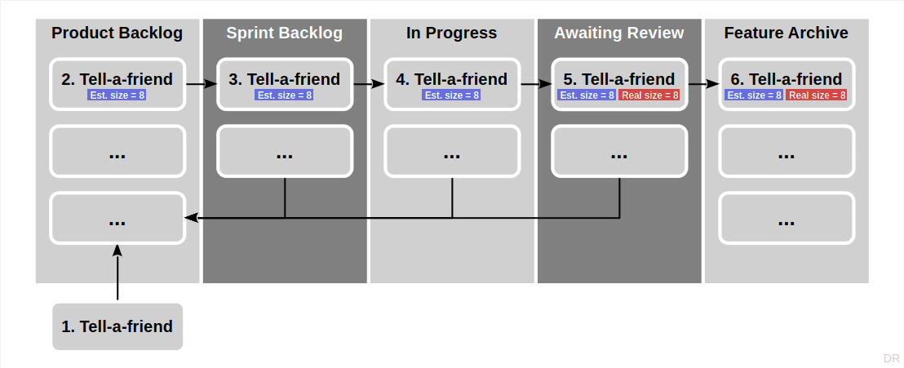
Example Feature Board and Backlog Items

Slide 32
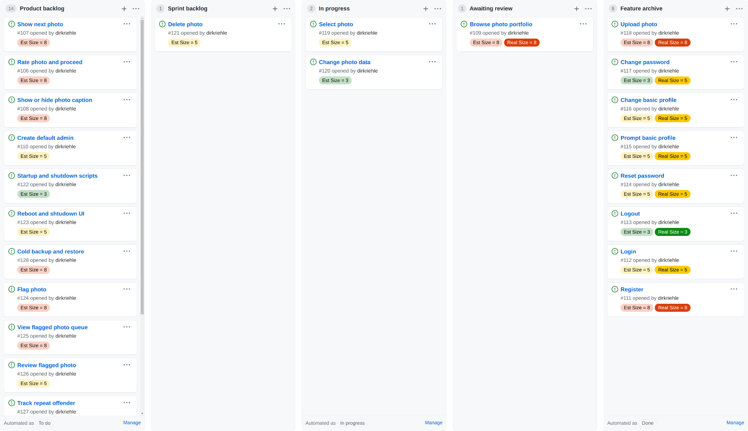
The illustrations show labels for estimated and real sizes. Instead of using labels, please use custom fields (see board settings). Please create the two custom fields “Estimated size” and “Real size” of type number.

Slide 33
Backlog Items (Also: Issue, Work Item, Ticket)
A backlog item is an
Ideally semantically closed task that needs doing
Types of backlog items
Features (functional and non-functional user requirements)
Refactorings (behavior-preserving code improvements)
Bug fixes (fixes to malfunctioning code)
We use GitHub issues to represent backlog items
Either by directly entering them into the GitHub project (the feature board)
Or by entering them as an issue, also assigning them to the feature board

Slide 34
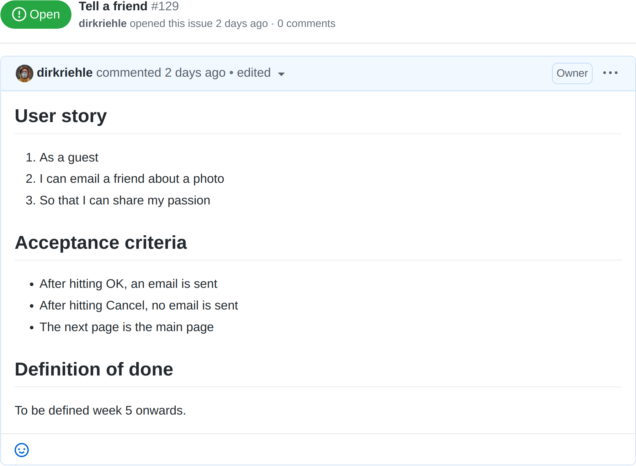
Example Issue Using User Story Format

Slide 35
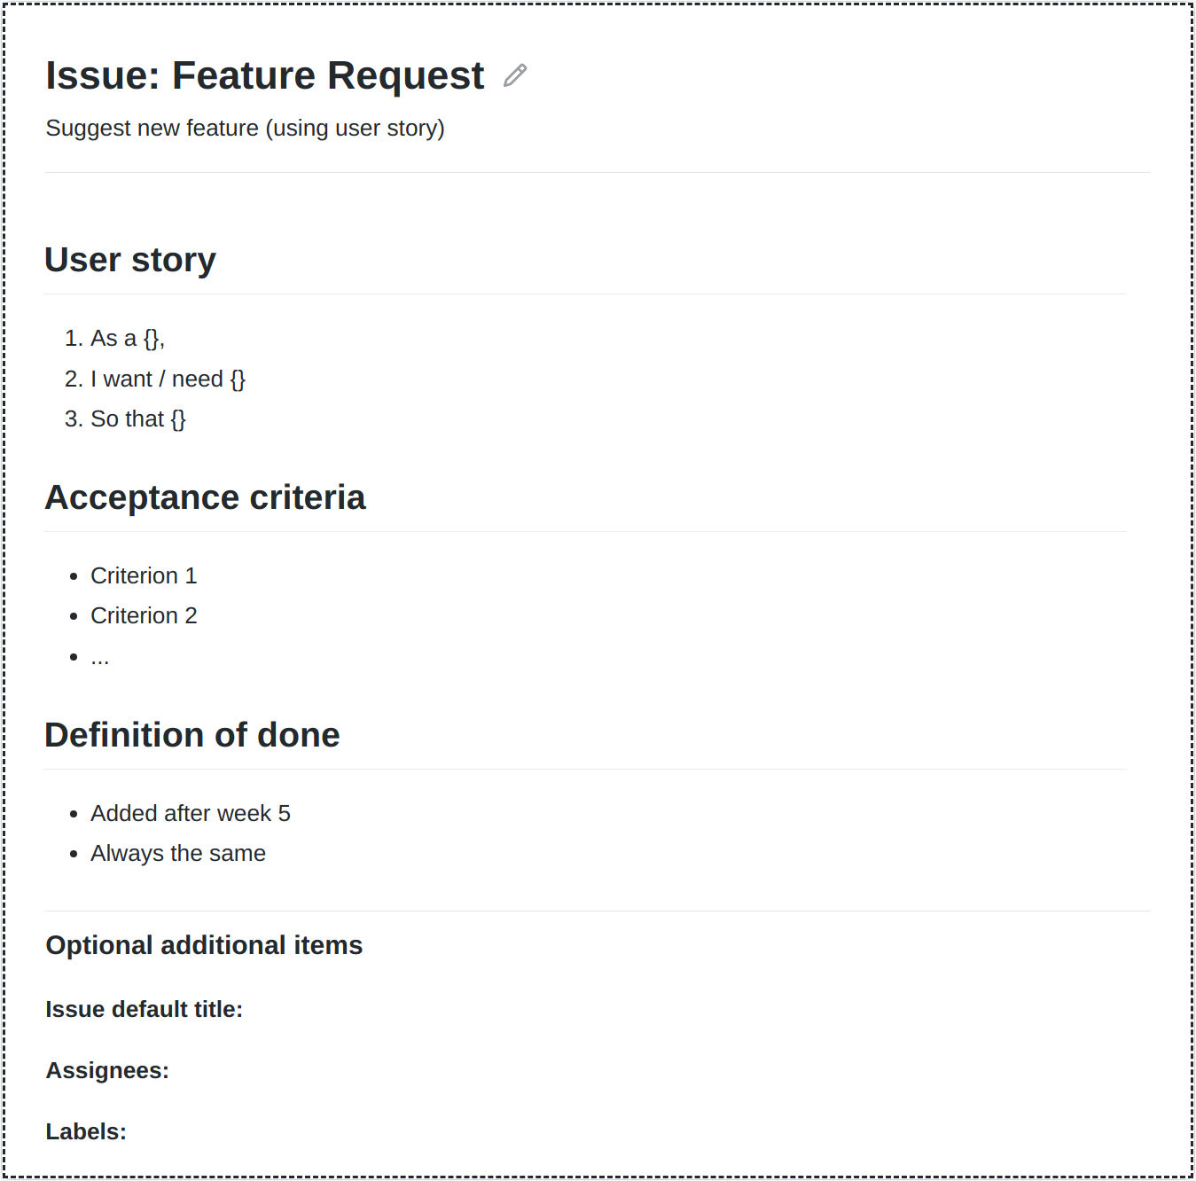
Issue Templates
Please create a template for feature requests
The template should contain fields for
Short name (already preset as title field)
Short description (using user story)
Acceptance criteria (to test for fulfillment)
Definition of done (from sprint 5 on)
Create custom fields for features sizes
Estimated size = X for estimated sizes
Set during sprint planning
Real size = Y for actual size
Set during sprint review
Feel free to add other templates

Slide 36
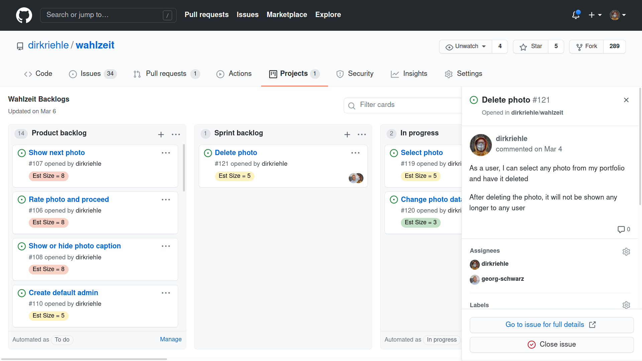

Slide 37
Regular Deliverable: Feature Board
Please initialize your feature board and keep it up-to-date
For the initial content, meet with your industry partner asap
Commit a screenshot of your feature board

Slide 38
6. Imp-Squared Backlog

Slide 39
Impediments and Improvements (Imp-Squared) Backlog
The imp-squared backlog is a slotting system used to
Manage the processing state of project impediments and improvements
Impediments are non-technical problems that are
Holding the team and project back
Improvements are non-technical desires to
Improve team performance

Slide 40
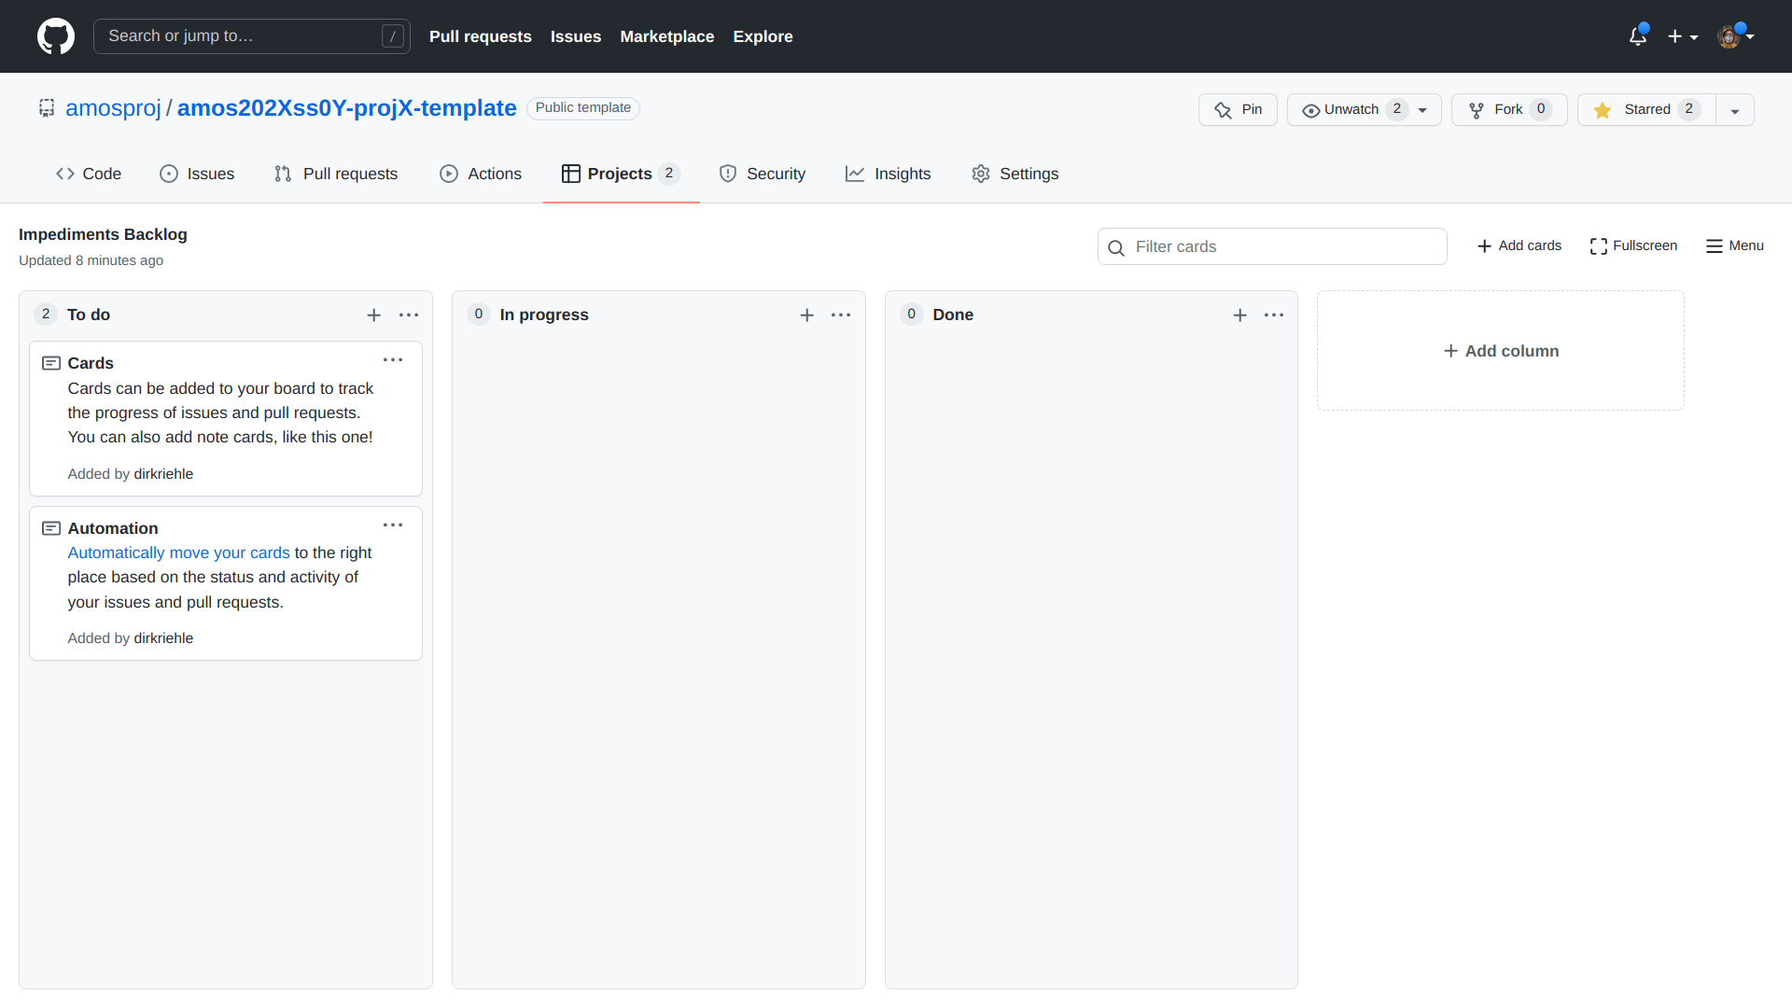

Slide 41
Regular Deliverable: Imp-Squared Backlog
Please initialize your imp-squared backlog and keep it up-to-date
Commit a screenshot of your imp-squared backlog

Slide 42
7. Code Repository

Slide 43
Git User Setup
Please use only one account and one email address and stick to it
Please configure your name and email address for your local repository
Please make sure this is the same information as on github.com
dirk@host$ git config --local user.name "Dirk Riehle"
dirk@host$ git config --local user.email "dirk@riehle.org"

Slide 44
Git Commit Sign-off
Please sign-off on your commits as your work using –signoff
This will add your name and email address to the commit message
This signifies that you agree with the project license
dirk@host$ git commit -m "Fixed issue #123" --signoff

Slide 45
Pair Programming / Co-Authoring
If you are pair programming, please make sure you document this in your commits
Add “Co-authored-by:” to commit message using the correct email address
Double-check the syntax (otherwise co-authorship will not be recognized)
Each co-authored-by needs to be on its own line to be recognized
Declaring collaboration in the feature board is not enough
Please find more detailed information on GitHub
dirk@host$ git commit -a -m "Fixed problem
>
>
Co-authored-by: Stefan Buchner <stefan.buchner@fau.de>"

Slide 46
Making Your Work Count
We use git, not GitHub [1], to look at your work
If you want your work to count,
Do not squash your commits
Do not delete branches with relevant work
[1] The GitHub interface / GitHub insights does not display your data correctly

Slide 47
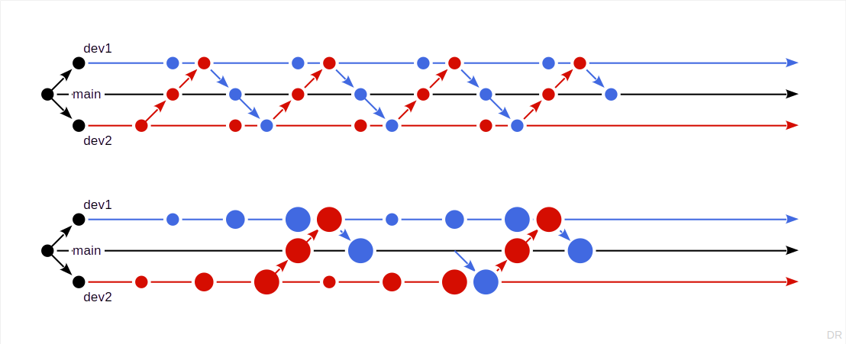
Choosing a Collaboration Model

Slide 48
The AMOS Project Licenses
For source code, we use the MIT license
See https://opensource.org/licenses/MIT
For other data, we use the CC BY 4.0 license
See https://creativecommons.org/licenses/by/4.0/

Slide 49
License and Copyright Declaration in Files
Please use the REUSE SOFTWARE [1] format to declare license and copyright
Alternatively, just track license and contributors in MIT license file
// SPDX-License-Identifier: MIT
// SPDX-FileCopyrightText: 2010-2021 Dirk Riehle <dirk@riehle.org>
// SPDX-FileCopyrightText: 2019 Georg Schwarz <georg.schwarz@fau.de>
[1] See https://reuse.software/

Slide 50
Open Source Governance
Do not add copyleft-licensed libraries to your project
Follow these rules of thumb on license choice
OK: Permissive licenses (MIT, BSD, Apache)
May be OK: Weakly protective (a.k.a. “weak copyleft”)
Usually not OK: Strongly protective (a.k.a. “reciprocal” or “copyleft”)
Never OK: Non-software licenses, no license
Professionals (i.e. companies) use code scanners to check

Slide 51
8. Stand-up Emails

Slide 52
Stand-up Emails
Stand-up emails are a communication mechanism that serves to
Ensure regular updates about each other’s work state / progress
When writing a stand-up email, please consider these three topics
What did you get done since you last sent a stand-up email?
What are your next steps / plans of work to do?
What challenges are you facing?
Separate from the stand-up emails, feel free to
Have your own communication channels

Slide 53
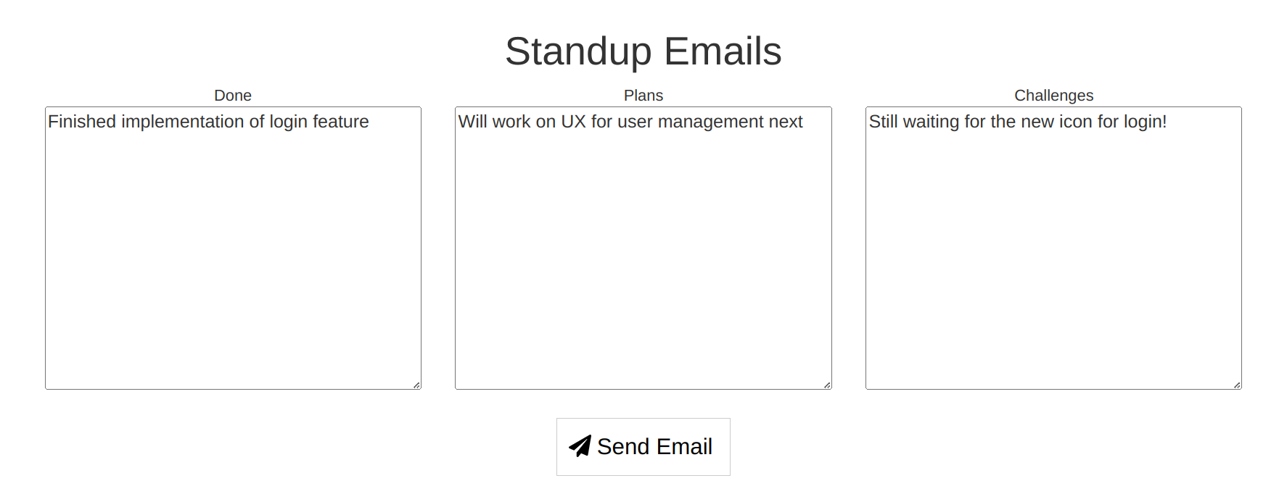
Regular Deliverable: Stand-up Emails
Please send stand-up emails using the tool https://happy-amos.appspot.com/
At least twice in total, on different days of the week

Slide 54
9. Happiness Index

Slide 55
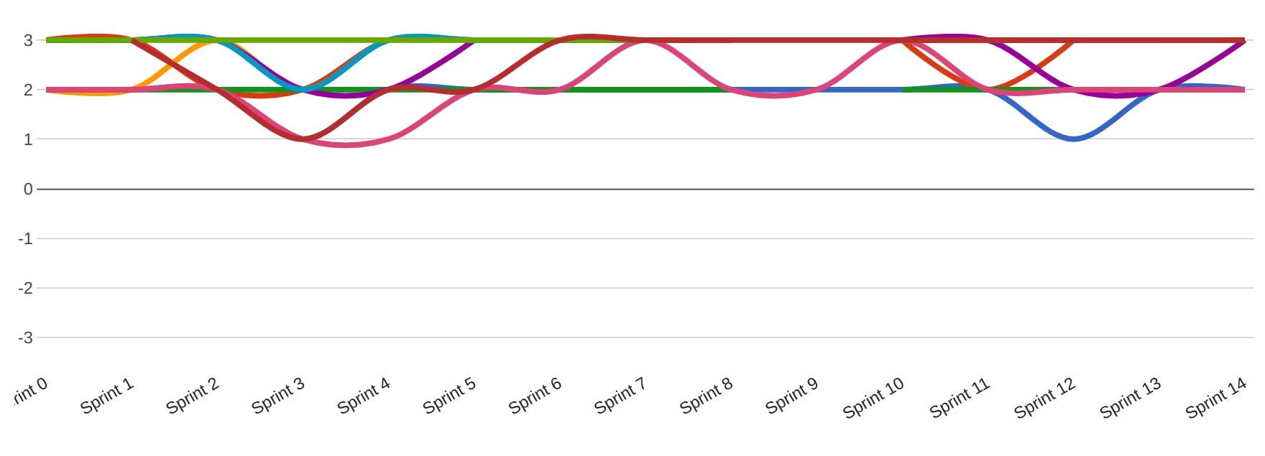
Happiness Index [1]
The happiness index tracks general satisfaction to indicate potential problems
[1] Originally: Emotions Seismograph

Slide 56
Regular Deliverable: Happiness Index
Please indicate your happiness using the tool https://happy-amos.appspot.com/
Every team meeting, including the first and last one, until end of day
Your contributions (your happiness) remains anonymous

Slide 57
Summary
Team formation
Student roles
Team contract
Team logo and T-shirt
Project tools
Planning document
Feature board
Imp-squared backlog
Team coordination
Code repository
Stand-up emails
Happiness index

Slide 58
Thank you! Any questions?
dirk.riehle@fau.de – https://oss.cs.fau.de
dirk@riehle.org – https://dirkriehle.com – @dirkriehle

Slide 59
Legal Notices
License
Licensed under the CC BY 4.0 International license
Copyright
© Copyright 2009, 2024 Dirk Riehle, some rights reserved

